Slide 1


Slide 2
Analyzing & Visualizing Petrochemical Data
Using
Rule Engine & Big Data Technologies
By Shravan C
Under Guidance of:
Sucharitha Shetty Sajeesh George
Assistant Professor Project Manager
MIT,Manipal HTS,India

Slide 3
Table of Contents
GENERAL INTRODUCTION TO THE TOPIC
Introduction
Learning Objectives of this Internship
PROJECT INITIALIZATION PHASE
Background Study
Problem Definition
Area of Computer Science
Methodology
Platform Setup
PROJECT IMPLEMENTATION PHASE
Implementation and Framework
Progress made & Remaining Work
CONCLUSION

Slide 4

GENERAL INTRODUCTION TO THE TOPIC:
Data can be Collected from :-

Slide 5
GENERAL INTRODUCTION TO THE TOPIC:
Data can be Collected from :-
Nuclear Power Plants

Slide 6
GENERAL INTRODUCTION TO THE TOPIC:
Data can be Collected from :-
Nuclear Power Plants
Petrochemical Plants

Slide 7
GENERAL INTRODUCTION TO THE TOPIC:
Data can be Collected from :-
Nuclear Power Plants
Petrochemical Plants
Oil & Gas Plants

Slide 8
GENERAL INTRODUCTION TO THE TOPIC:
Data can be Collected from :-
Nuclear Power Plants
Petrochemical Plants
Oil & Gas Plants
Any Plant that Produces Renewable Fuels

Slide 9
GENERAL INTRODUCTION TO THE TOPIC:
Data can be Collected from :-
Nuclear Power Plants
Petrochemical Plants
Oil & Gas Plants
Any Plant that Produces Renewable Fuels
10,721,476,618,982,102

Slide 10
GENERAL INTRODUCTION TO THE TOPIC:
Data can be Collected from :-
Nuclear Power Plants
Petrochemical Plants
Oil & Gas Plants
Any Plant that Produces Renewable Fuels
10,721,476,618,982,102
10.7 Peta Bytes of Data

Slide 11

Learning Objectives :-
To learn, install and configure various Big-data Softwares:
Drools Rule Engine
Eclipse IDE Spark Scala Jars & Plugins
Drools Kie Work-Bench
Tableau

Slide 12
Learning Objectives :-
To learn, install and configure various Big-data Softwares:
Drools Rule Engine
Eclipse IDE Spark Scala Jars & Plugins
Drools Kie Work-Bench
Tableau
To get familiar with programming languages & Platform used :
Java programming Language for Drools Rule Engine
Apache Spark

Slide 13
Learning Objectives :-
To learn, install and configure various Big-data Softwares:
Drools Rule Engine
Eclipse IDE Spark Scala Jars & Plugins
Drools Kie Work-Bench
Tableau
To get familiar with programming languages & Platform used :
Java programming Language for Drools Rule Engine
Apache Spark
To learn to solve problems in Chemical industries:
Solved many usecases

Slide 14
Learning Objectives :-
To learn, install and configure various Big-data Softwares:
Drools Rule Engine
Eclipse IDE Spark Scala Jars & Plugins
Tableau
Drools Kie Work-Bench
To get familiar with programming languages & Platform used :
Java programming Language for Drools Rule Engine
Apache Spark
To learn to solve problems in Chemical industries:
Solved many usecases
To visualize and predict insights from various Datasets using Tableau Tool:
Solved 2 usecases

Slide 15
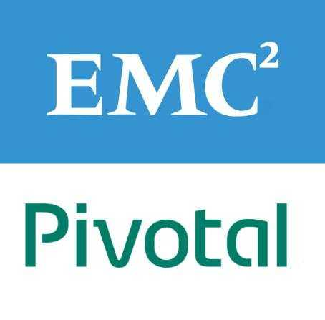
PROJECT INITIALIZATION PHASE:
Background Study :-

Slide 16
PROJECT INITIALIZATION PHASE:
Background Study :-
Current Solution is Expensive

Slide 17
PROJECT INITIALIZATION PHASE:
Background Study :-
Current Solution is Expensive
Works best with Aggregated Data of each Day

Slide 18
PROJECT INITIALIZATION PHASE:
Background Study :-
Current Solution is Expensive
Works best with Aggregated Data of each Day
It has High Write Load

Slide 19
PROJECT INITIALIZATION PHASE:
Background Study :-
Current Solution is Expensive
Works best with Aggregated Data of each Day
It has High Write Load
Rebuilding the entire database takes almost 2 days

Slide 20

PROJECT INITIALIZATION PHASE:
Background Study :-
Hadoop BigData Solution is :-
Is Cheaper (Open Source)
More stable
Equally performant
Far less vendor lock-in

Slide 21
PROJECT INITIALIZATION PHASE:
Problem Definition :-
Detecting fault based model using Drools Rule Engine

Slide 22
PROJECT INITIALIZATION PHASE:
Problem Definition :-
Detecting fault based model using Drools Rule Engine
Building a complex event processing (CEP) solution that operates on big data, to produce scalable and real time insights in decision making using Drools Rules Engine and Apache Spark

Slide 23
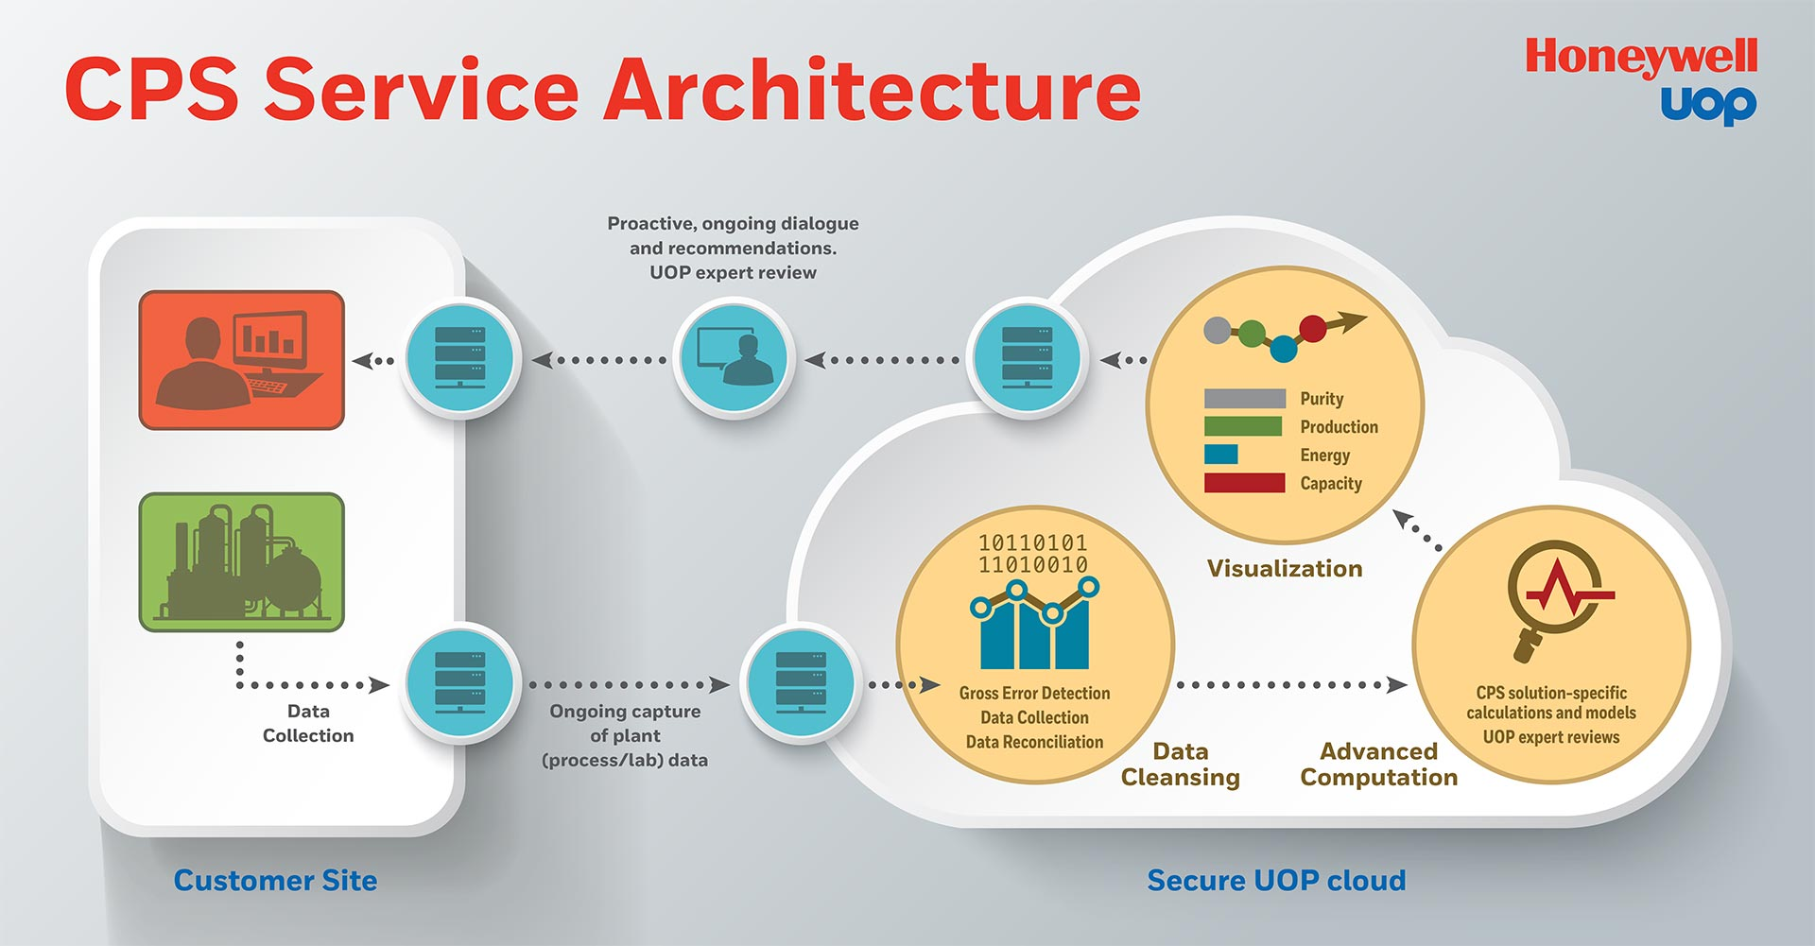
PROJECT INITIALIZATION PHASE:
Problem Definition :-
Detecting fault based model using Drools Rule Engine
Building a complex event processing (CEP) solution that operates on big data, to produce scalable and real time insights in decision making using Drools Rules Engine and Apache Spark

Slide 24
PROJECT IMPLEMENTATION PHASE:
Connected Performance Service ( CPS ) Architecture :-

Slide 25
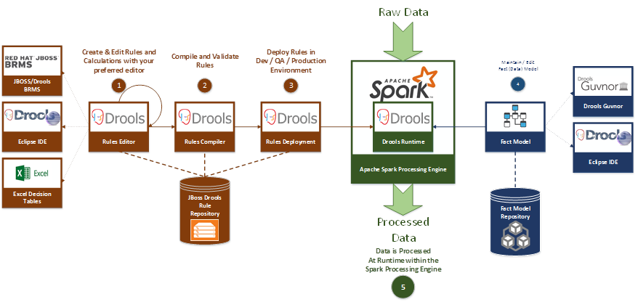
PROJECT IMPLEMENTATION PHASE:
Connected Performance Service ( CPS ) :-

Slide 26
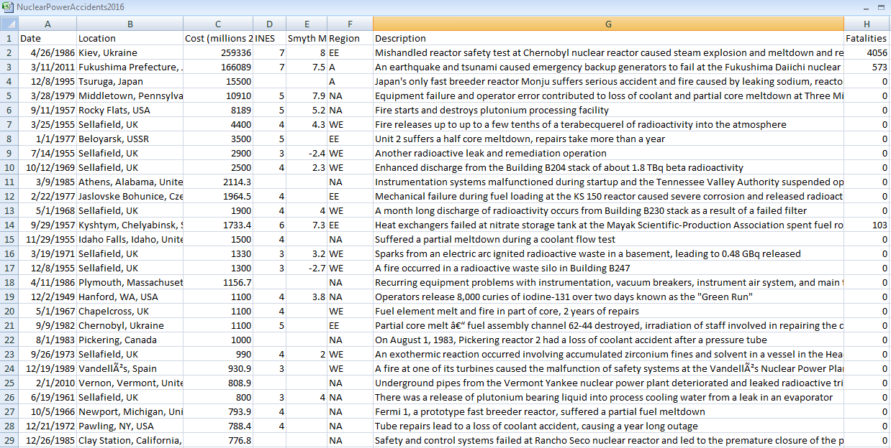
PROJECT IMPLEMENTATION PHASE:
Implementation of Sample Nuclear Dataset in Rule Engine:
Dataset Source: https://data.world/rebeccaclay/nuclear-power-accidents/file/C_id_35_NuclearPowerAccidents2016.csv

Slide 27
PROJECT IMPLEMENTATION PHASE:
Implementation of Sample Nuclear Dataset in Rule Engine:
Input :-
All Nuclear Power Accidents happened till 2016
Around 200 Rows with each column separated by comma
Problem Solved :-
Finds how many nuclear power accidents took place in particular date range.
Finds how many nuclear power accidents took place in particular Region/Country.
Helps in determining the common cause for nuclear Power Accidents

Slide 28
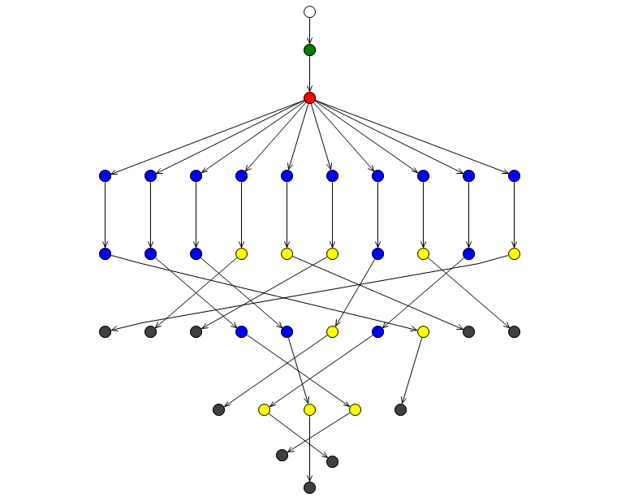
PROJECT IMPLEMENTATION PHASE:
Implementation of Sample Nuclear Dataset in Rule Engine:
Output :-
An Action is Triggered ( For simplicity I have just printed out Text )
for Eg: Equipment failure and operator error contributed to loss of coola ... Rule 8 fired!
rule “Name of the Rule"
when
Condition
then
Action Triggered
end

Slide 29
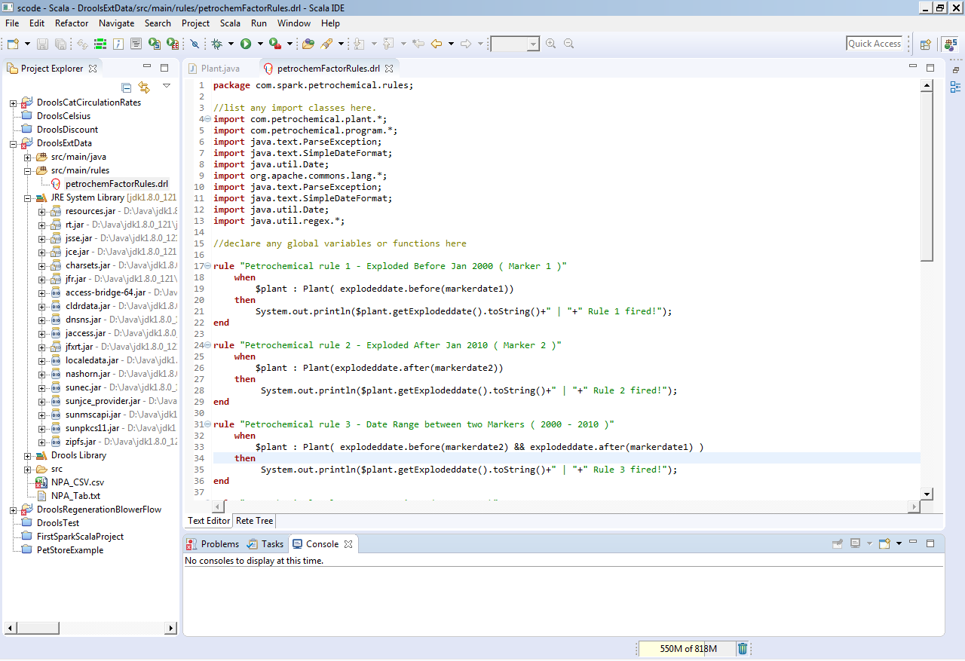
Implementation of Sample Nuclear Dataset in Rule Engine:

Slide 30
PROJECT IMPLEMENTATION PHASE:
Implementation of Petrochemical use-case in Rule Engine:
Input :-
Around 300 Rows with each column separated by comma
Problem Solved :-
If Tag1 is lower than both Tag2 & Tag3 then the device is said to be faulty
If Tag1 is lower than Tag2/Tag3, Then I have given Recaliberation Alert for those values of the dataset to recaliberate.

Slide 31
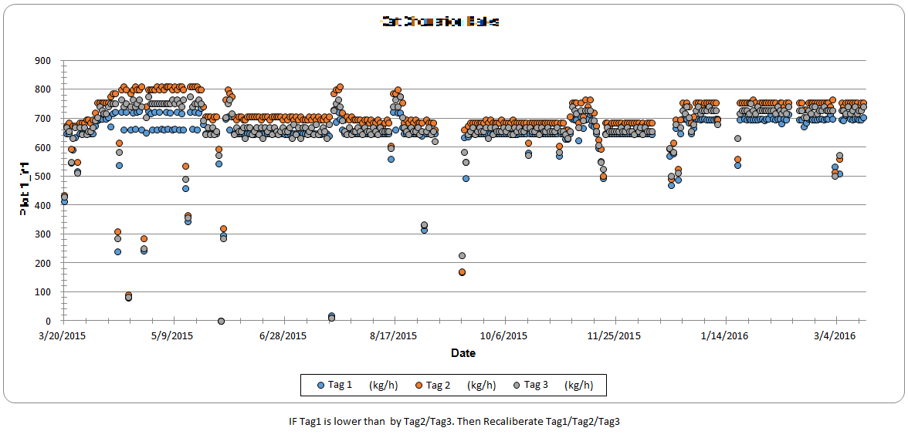
Implementation of Petrochemical use-case in Rule Engine:

Slide 32
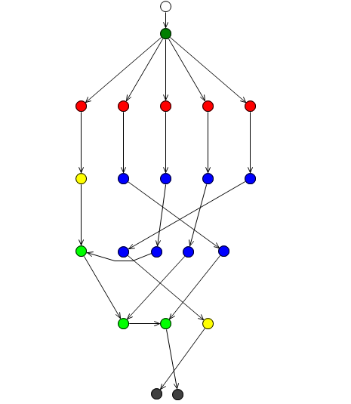
PROJECT IMPLEMENTATION PHASE:
Implementation of Petrochemical use-case in Rule Engine:
Output :-
Recaliberate Alert: Tag1 Value: 703.8 is lower than 753.5 , 740.4 Tag2/Tag3 Values
Rule Chaining
rule “Rule1"
when
Condition
then
Action Triggered
end
rule “Rule2"
when
Condition
then
Action Triggered
end

Slide 33
PROJECT IMPLEMENTATION PHASE:
Implementation of Petrochemical use-case in Rule Engine:
Input :-
Around 400 Rows with each column separated by comma
Problem Solved :-
Analyzed Dataset by Detecting Slope values whether it is increasing or Decreasing
rule “Rule1“
Salience 100
no-loop true
when
Condition
then
Action 1 Triggered
end
rule “Rule2“
Salience 80
no-loop false
when
Condition
then
Action 2 Triggered
end

Slide 34
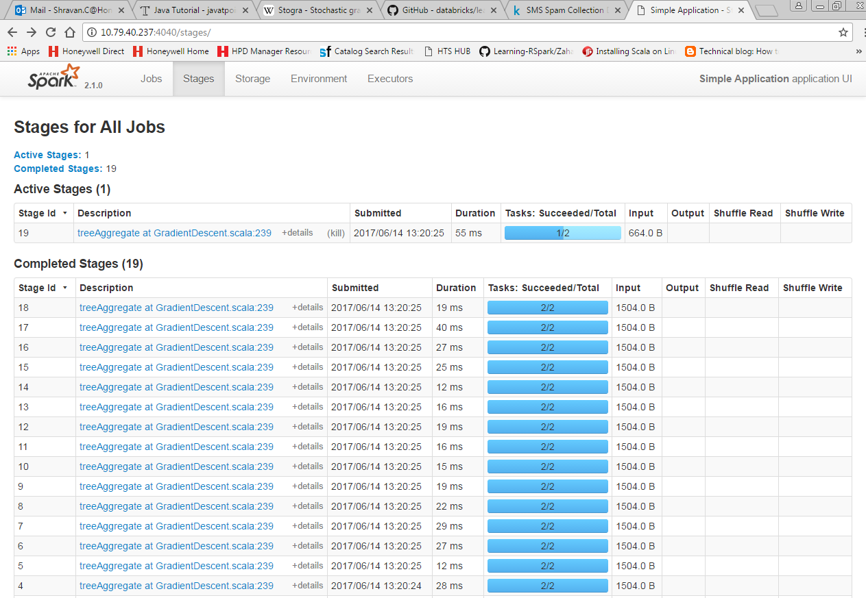
PROJECT IMPLEMENTATION PHASE:
Spark implementation in Drools Rule Engine:

Slide 35
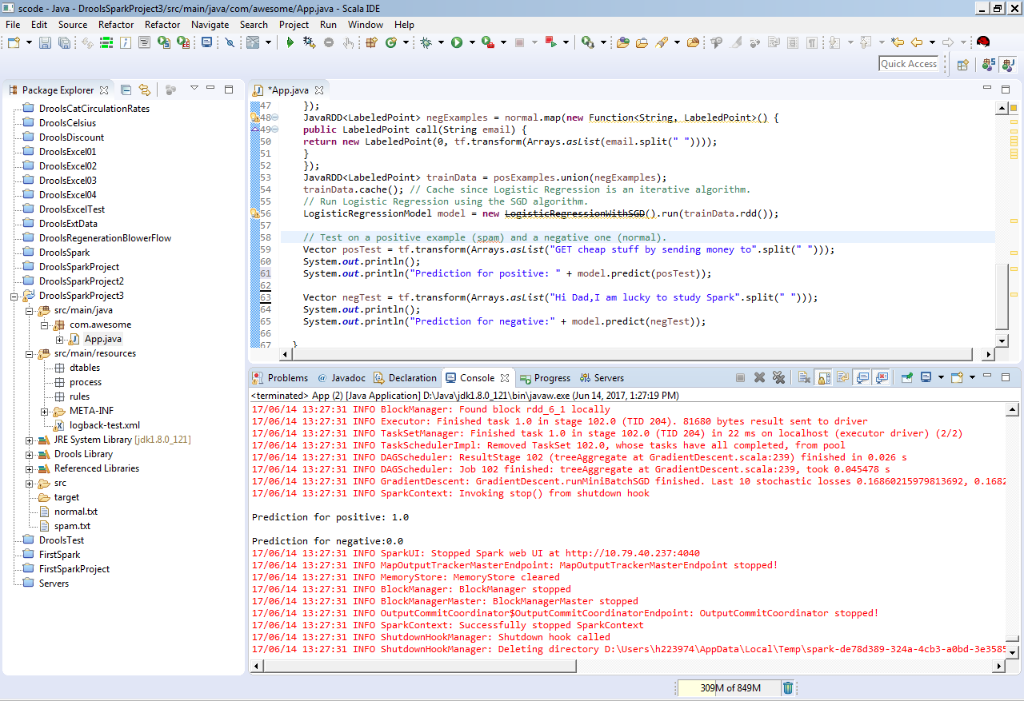
PROJECT IMPLEMENTATION PHASE:
Spark ML implementation in Drools Rule Engine:

Slide 36
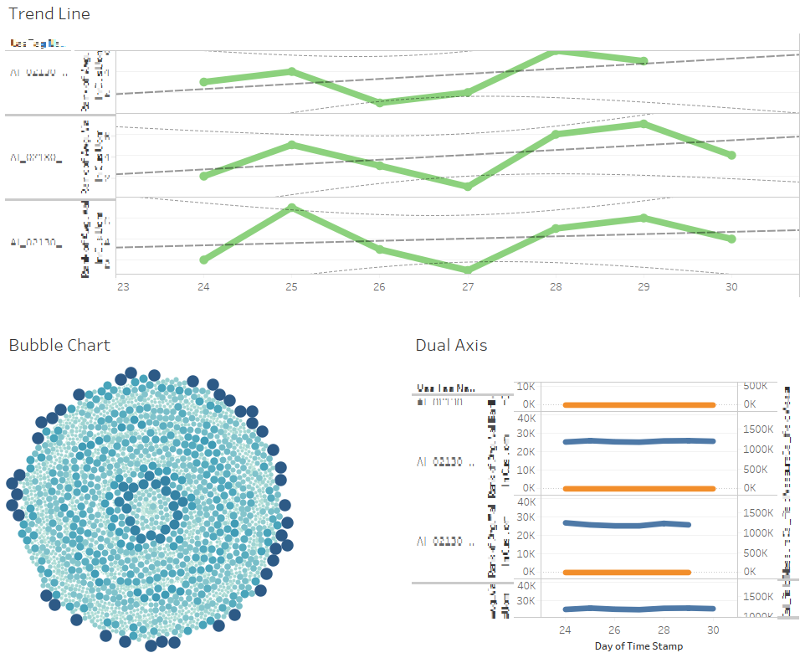
PROJECT IMPLEMENTATION PHASE:
Data Visualization using Tableau Tool:

Slide 37
THINGS LEARNT SO FAR :
Learnt to setup various Bigdata Softwares like Rule Engine, Apache Spark, Hortonworks
Solved 1 sample use case using nuclear dataset
Solved 2 Real-Time use case using Honeywell UOP Petrochemical dataset
Got Hands-On experience with Tableau Data Visualization Tool
REMAINING WORK:
Usage of Drools Rule Engine in Apache Spark Environment for real time decision making

Slide 38
CONCLUSION:
Got very good industrial exposure by solving various practical use cases
Got opportunity to meet & work with various super hardworking people
“It always seems impossible until it is done.” – Nelson Mandela

Slide 39


